Slide 1


Displaying curves and surfaces in
3D system
NTU SCSE Final Year Project: SCSE18-0105
By KHIEW JIAN BIN
Supervised by Assoc Prof Alexei Sourin

Slide 2
Project objective
Investigate a new software that can replace NTU’s 3D visualization software FVRML
To:
Display curves, surfaces and solid objects using parametric and implicit functions.
Give an intuitive UI and ease the process of editing and executing the functions.
Proposed software
Unity 3D engine

Slide 3
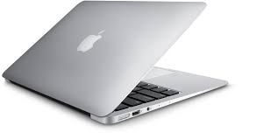
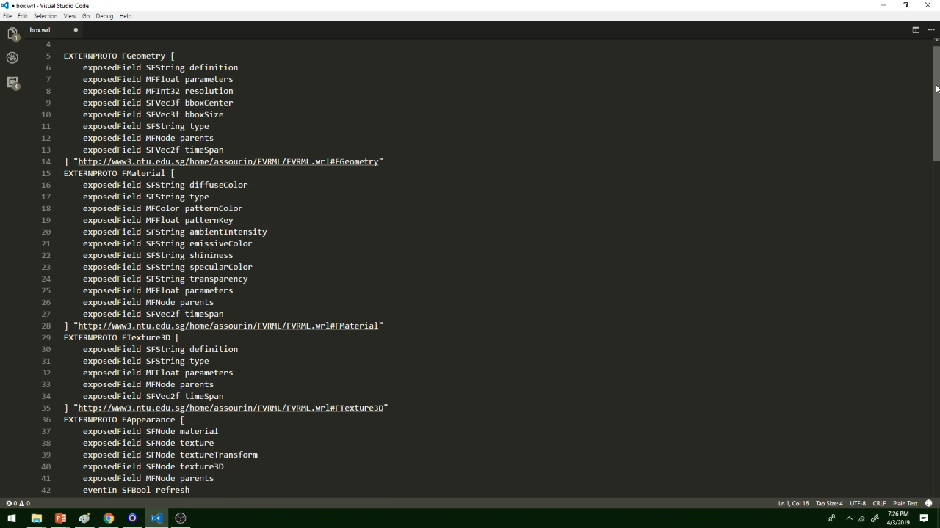





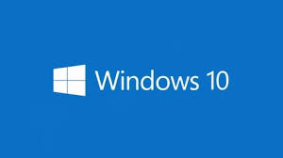

Step 3. Run using?
Step 2. Edit file
Mac
Too many steps and restrictions!!
Step 1. Open file
Android
Visualize Shapes: The old way
Box.wrl
Box.wrl
+

Slide 4
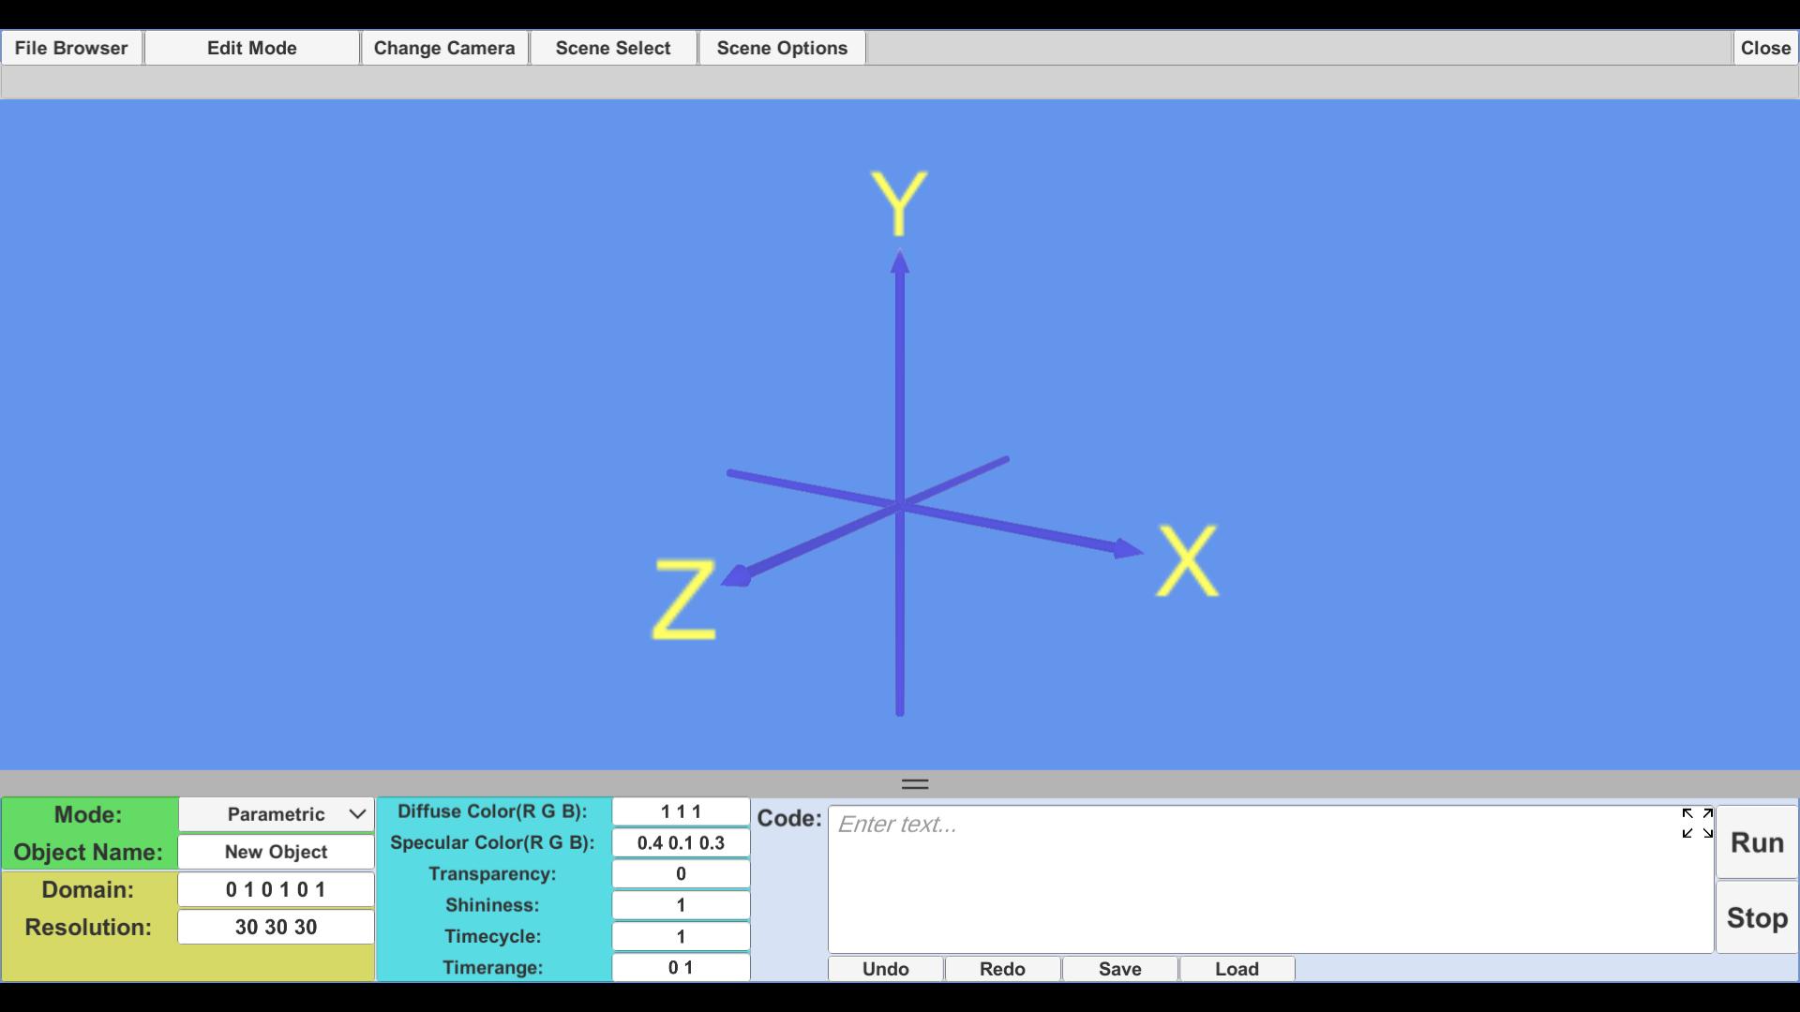
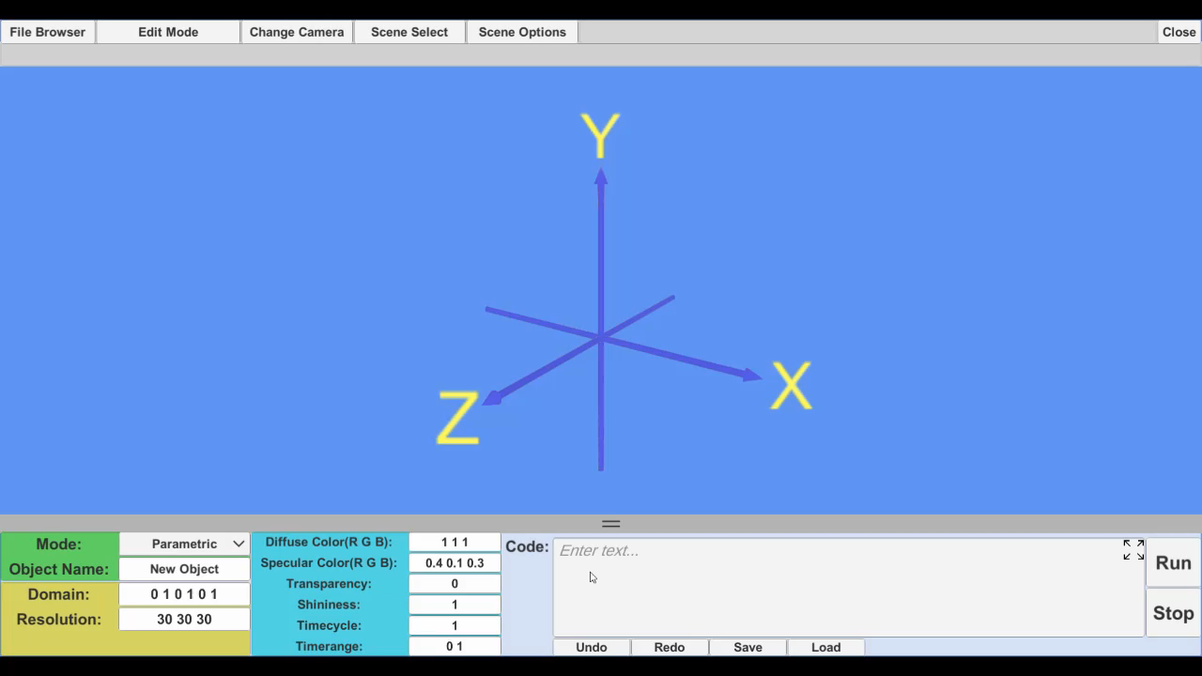
Step 1. Run Unity
Process Simplified
Visualize Shapes: The
way
Unity.exe
Step 2. Edit and Run

Slide 5
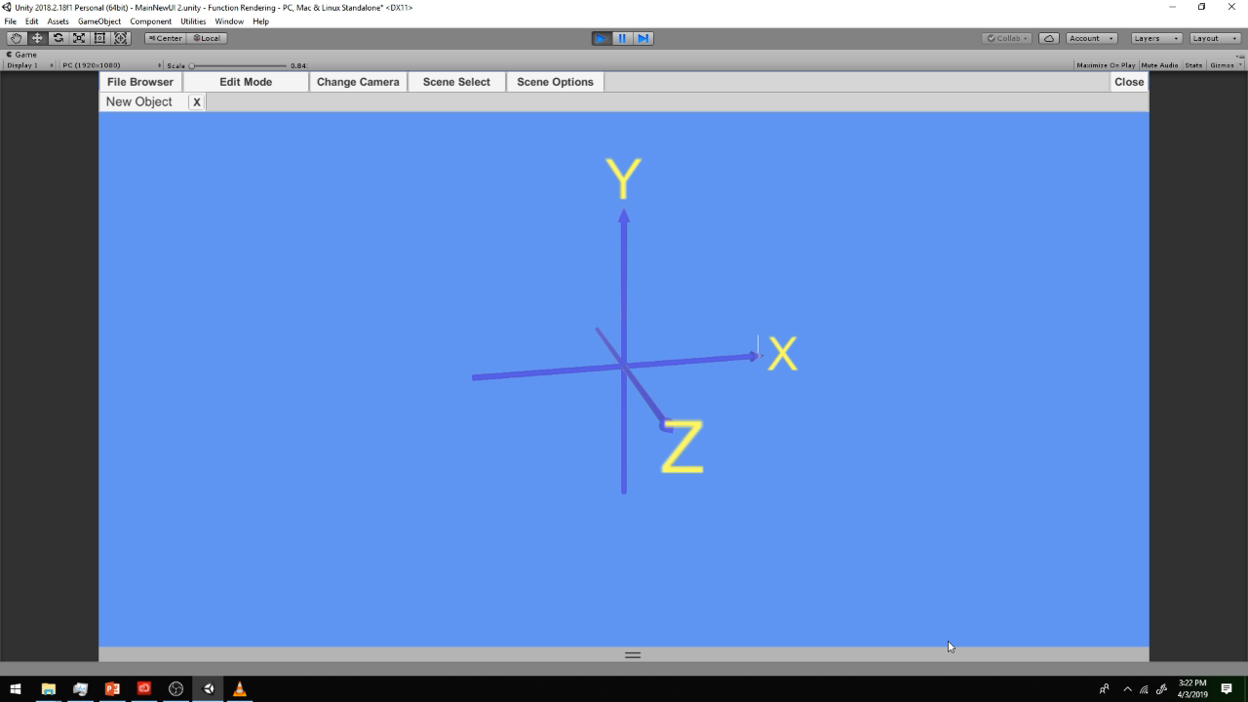
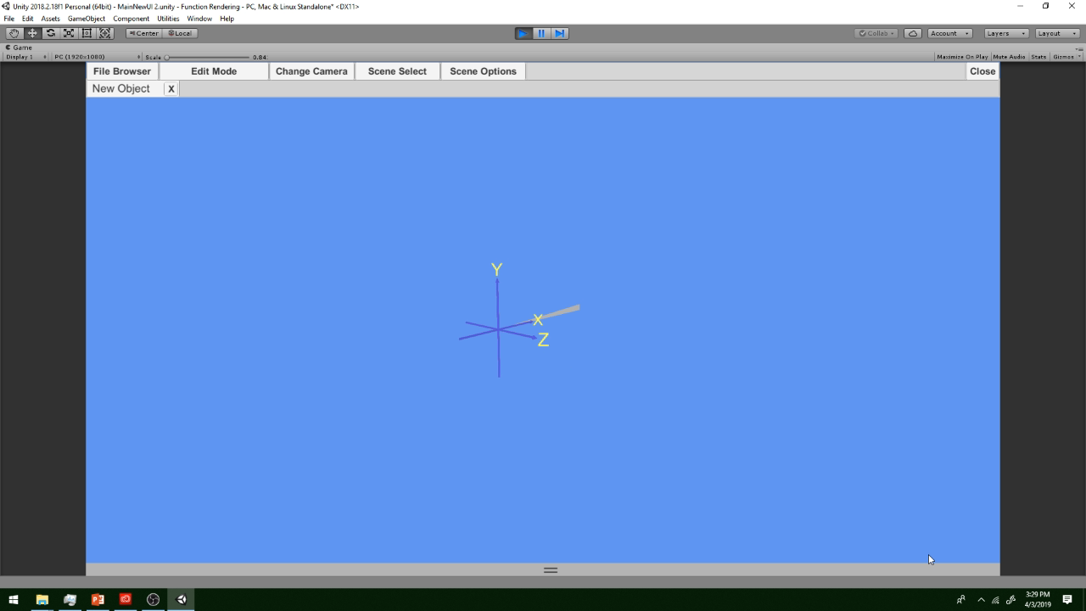
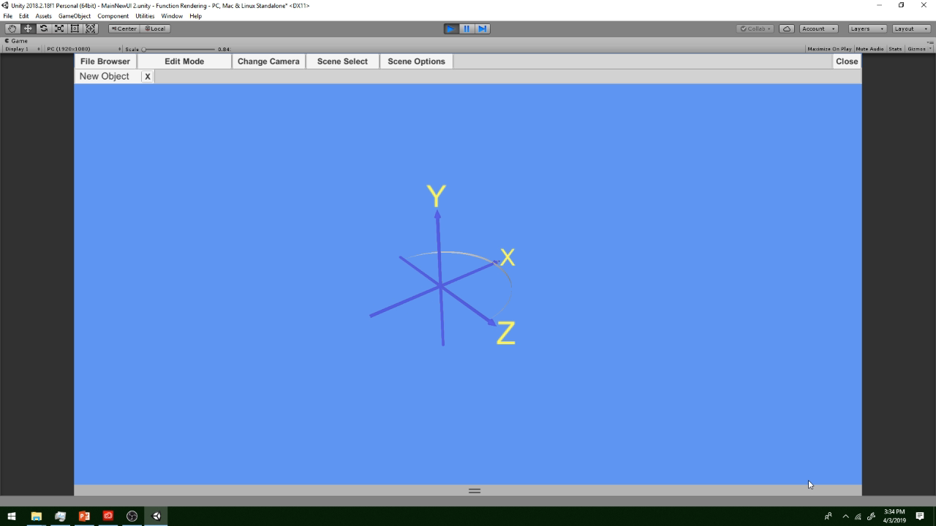
Edit, Run and Visualize All In one Screen
Parametric
Curves
Surfaces
Solids

Slide 6
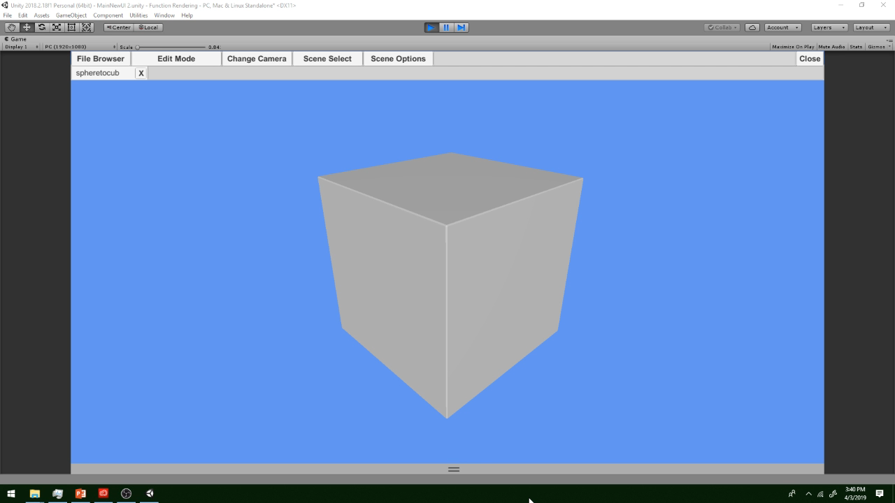
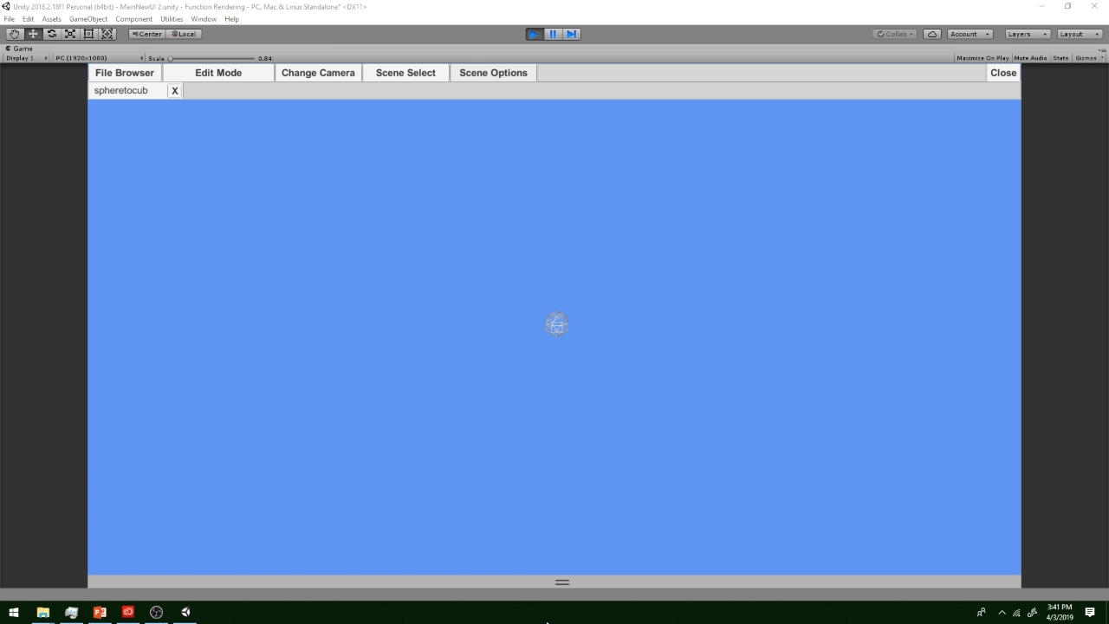
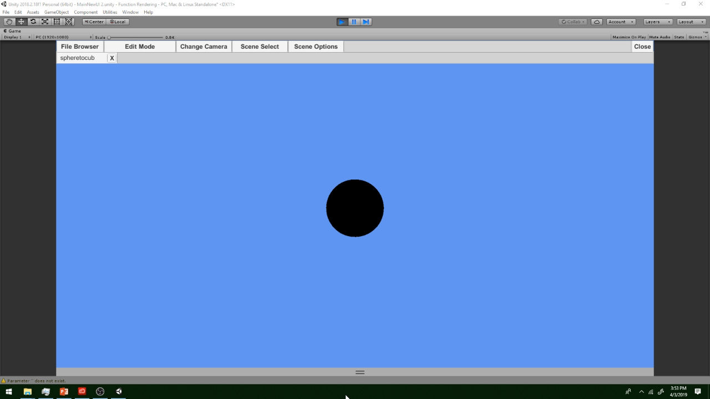
Edit, Run and Visualize All In one Screen
Implicit and More
Sphere To Cube
Wireframe
RGB Cube

Slide 7
Supported Features
Runs on Windows, MacOS, IOS and Android
Internal file manager
Save & Load
Programming style edit format
Custom user variable
Time parameter variable
Undo and Redo editing

Slide 8
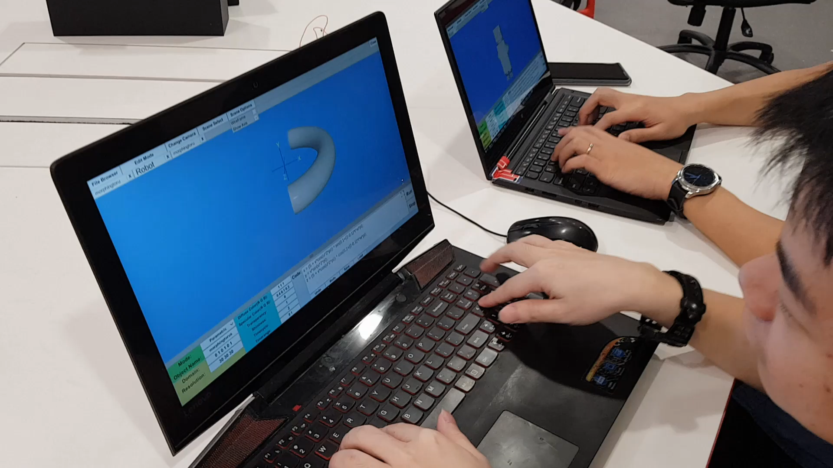
User Study & Tests

Slide 9
Conclusion
Unity 3D is able to display curves and surfaces using parametric and implicit functions though the use of
a flexible UI.
This new software can be considered as a successor of NTU’s 3D visualization software FVRML.

Slide 10
Thanks For Watching
Special Thanks
Nanyang Technological University
School of Computer Science and Engineering
User Study Participants

